Slide 1
Java EE
Servlet overview & Servlet Life Cycle
Servlet Interface
Implementations:
GenericServlet & HttpServlet
MIME Types
Creating WAR file
Processing HttpRequest & HttpResponse Headers
Handling form data
ServletContext & ServletConfig objects

Slide 2
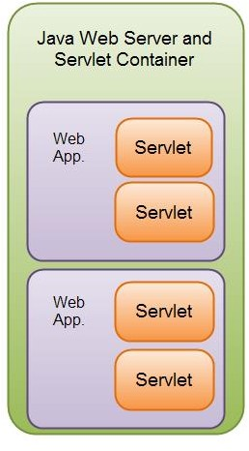
Servlet Overview
Although servlets can respond to any type of request, they are commonly used to extend the applications hosted by web servers.
For such applications, Java Servlet technology defines HTTP-specific servlet classes.
The javax.servlet and javax.servlet.http packages provide interfaces and classes for
writing servlets.
All servlets must implement the Servlet interface, which defines lifecycle methods.
When implementing a generic service, you can use or extend the GenericServlet class provided with the Java Servlet API.
The HttpServlet class provides methods, such as doGet() and doPost() , for handling HTTP-specific services.
A Servlet is one of the main web components of a Java web application.
A Servlet container may run multiple web applications and each web application may have multiple servlets running inside.

Slide 3
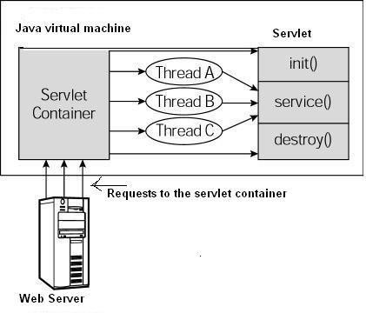
Servlet Lifecycle
The lifecycle of a servlet is controlled by the container in which the servlet has been deployed.
When a request is mapped to a servlet, the container performs
the following steps.
If an instance of the servlet does not exist, the web container
Loads the servlet class.
Creates an instance of the servlet class.
Initializes the servlet instance by calling the init() method.
Spawns a new thread , hands over the control to the thread
This thread invokes the service method, passing request and response objects.
In case your servlet extends HttpServlet, the service() method which receives the request will pass on to doGet() or doPost() methods depending on method type.
If it needs to remove the servlet, the container finalizes the servlet by calling the servlet’s destroy method.

Slide 4
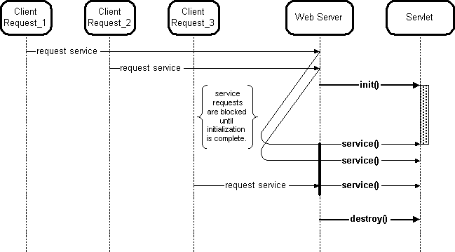
Basic interactions between clients, a web server, and a servlet registered with the web server

Slide 5
Servlet API

Slide 6
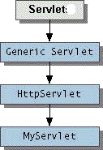
Servlet Lifecycle Methods
The central abstraction in the Servlet API is the Servlet interface.
All servlets implement this interface, either directly or indirectly, more commonly,
by extending a class that implements it such as HttpServlet.
The Servlet interface contains abstract methods that define the servlet lifecycle.
Rarely servlets directly implement Servlet interface.
The Servlet interface provides the following methods that manage the servlet and its communications with clients.
destroy() : Cleans up whatever resources are being held and makes sure that any
persistent state is synchronized with the servlet's current in-memory state.
getServletConfig() : Returns a servlet config object, which contains any initialization parameters and startup configuration for this servlet.
getServletInfo() :Returns a string containing information about the servlet, such as its
author, version, and copyright.
init(ServletConfig) : Initializes the servlet. Run once before any requests can be serviced.
service(ServletRequest, ServletResponse) : Carries out a single request from the client.

Slide 7
GenericServlet
public abstract class GenericServlet implements Servlet, ServletConfig, java.io.Serializable
GenericServlet is a generic, protocol-independent servlet.
GenericServlet implements the Servlet and ServletConfig interfaces.
GenericServlet may be directly extended by a servlet, although it's more common to extend a protocol- specific subclass such as HttpServlet.
GenericServlet makes writing servlets easier. It provides simple versions of the lifecycle
methods init() and destroy() and also the methods in the ServletConfig interface. GenericServlet also implements the log method, declared in the ServletContext interface.
To write a generic servlet, you need only override the abstract service method.
public void service(ServletRequest request, ServletResponse response) throws ServletException,
IOException {
…
}

Slide 8
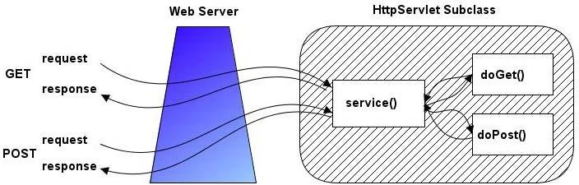
javax.servlet.http.HttpServlet
public abstract class HttpServlet extends GenericServlet implements java.io.Serializable
Defines a protocol-specific Servlet.
HttpServlet extends the GenericServlet and hence inherits the properties GenericServlet.

Slide 9
doGet() and doPost() methods of HttpServlet class
The doGet() Method
public void doGet(HttpServletRequest request, HttpServletResponse response) throws
ServletException, IOException {
// Servlet code
}
The doPost() Method
public void doPost(HttpServletRequest request, HttpServletResponse response) throws
ServletException, IOException {
// Servlet code
}
The doGet() and doPost() are most frequently used methods within each service request. So we have nothing to do with service() method. Override either doGet() or doPost() depending on what type of request you receive from the client.

Slide 10
What HttpServletRequest and HttpServletResponse objects contain?
The HTTP request received by the Web Server will be in the form of plain text. It will be difficult
for the programmer to parse this text and get the details.
So, the Servlet Container wraps all the information in the HttpServletRequest object.
The servlet container creates an HttpServletRequest object and passes it as an argument to the servlet's service methods (doGet, doPost, etc).
The Servlet can get all the details of the request by calling the methods of this object.
Similarly, the HTTP response is also in the form of plain text.
The HttpServletResponse object methods can be used by our servlets for creating responses.
The Servlet Container will convert this data into the format specified by the HTTP protocol
Note HttpServletRequest and HttpServletResponse are interfaces. The Servlet Container creates objects and passes them to service methods.

Slide 11
Creating First Servlet
@WebServlet(name="/MyFirstServlet",urlPatterns="/first")
public class MyFirstServlet extends HttpServlet {
private static final long serialVersionUID = 1L;
Servlet 3.x provides
the @WebServlet annotation to define a
servlet.
No need of entries in web.xml file.
protected void doGet(HttpServletRequest request, HttpServletResponse response) throws ServletException, IOException {
PrintWriter out=response.getWriter(); response.setContentType("text/html");
MIME Type
out.println("<html><h1><font color=\"blue\">"+"Welcome To My First
Servlet"+"</font></h1></html>");
}
URL
http://localhost:8080/MyFirstWebApp/first
protected void doPost(HttpServletRequest request, HttpServletResponse response)
throws ServletException, IOException {
doGet(request, response);
}
}

Slide 12
Multipurpose Internet Mail Extension (MIME)
The browser can accept many types of files like html, text and different kinds of images. Before sending
data to the browser, specify the type of that data so that browser can display the content properly.
Multipurpose Internet Mail Extension (MIME) is the standard that is used to specify the type of data to the browser.
MIME standard specifies a string for each data type –
"text/html" for HTML data,
"text/plain" for plain text data
"image/gif" for gif images etc.
The method setContentType(String mime) can be used for sending the MIME to the browser.
For ex. response.setContentType("text/html");

Slide 13
Deployment Descriptor file (web.xml)
Without Annotation ( @WebServlet )
….
<servlet>
<servlet-name>comingsoon</servlet-name>
<servlet-class>packagename.servletname</servlet-class>
</servlet>
<servlet-mapping>
<servlet-name>comingsoon</servlet-name>
<url-pattern>/pattern</url-pattern>
</servlet-mapping>
……
URI:
http://localhost:8080/context_root/pattern

Slide 14
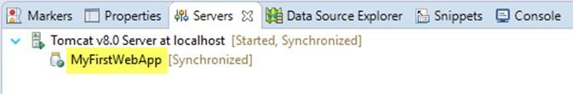

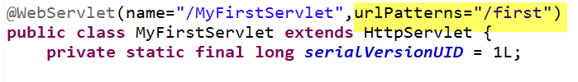

HTTP Request-Response Model
1. When a HTTP client requests for a resource, the HTTP Server will check whether the context root specified in the URL is currently deployed in the server.
2. If found, then it will look into the web component of the application with urlPattern matching with the pattern provided in the URL.
3. The servlet container performs the following tasks:
It creates an instance of the servlet and calls its init() method to initialize it.
It constructs a request object that is passed to the servlet via service() method. The request includes, among other
things:
Any HTTP headers from the client.
Parameters and values passed from the client (for example, names and values of query strings in the URL)
The complete URI of the servlet request.
It constructs a response object for the servlet.
It invokes the servlet service() method. Note that for HTTP servlets, the generic service method is usually overridden in the HttpServlet class methods, doGet() or doPost() methods, depending on the HTTP request type. (GET or POST)

Slide 15
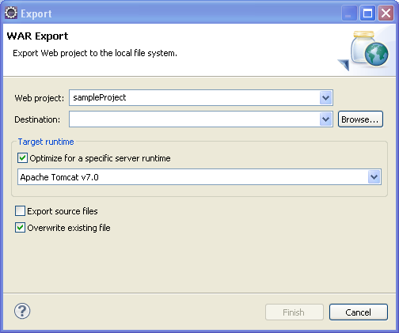
Creating & Deploying Web Application Archive (WAR) file
Right-Click on the project name(context-root) , Click on Export->WAR file
Type war file name, ex. sample.war and store in your file system.(Select the folder by clicking on Browse button and click on Finish button.
This war file can be deployed an any other Tomcat Server. We can make use of Tomcat Manager console to deploy the web application).
Click on Manager App button that you see on the Tomcat Home Page.
Enter user-id and password. You require manager-gui role to access this page
Edit the file, tomcat-users which is located in conf folder of tomcat installation directory:
Ex. C:\Program Files\apache-tomcat-8.0.24\conf
Remove the comments surrounding the roles and enter the following:
<role rolename="tomcat"/>
<role rolename="role1"/>
<role rolename="manager-gui"/>
<user username="tomcat" password= " tomcat" roles="manager-gui"/>
<user username="both" password="tomcat" roles="tomcat,role1"/>
<user username="role1" password="tomcat" roles="role1"/>

Slide 16
Java EE
HTTP Request & Response Header Methods

Slide 17
HTTP Request Header Methods
Reading Request Headers
(Important methods of HttpServletRequest interface)
General
– getHeader (parameter name)
– getHeaderNames()
Specialized
– getCookies()
getAuthType() and getRemoteUser()
getContentLength()
getContentType()
getDateHeader()
getIntHeader()
Related info
getMethod(), getRequestURI() ,
getQueryString(), getProtocol()

Slide 18
HTTP Response Header Methods
HttpServletResponse is a predefined interface present in javax.servlet.http package.
The response object is where the servlet can write information about the data it will send back.
The majority of the methods in the request object start with GET, indicating that they get a value, many of the important methods in the response object start with SET, indicating that they change some property.
public String encodeRedirectURL(String url) :Encodes the specified URL for use in the sendRedirect method or, if encoding is not needed, returns the URL unchanged.
public String encodeURL(String url) :Encodes the specified URL by including the session ID in it, or, if encoding is
not needed, returns the URL unchanged.
public void sendError(int sc) throws IOException :Sends an error response to the client using the specified status code and clearing the buffer.
public void sendRedirect(string location) throws IOException : Sends a temporary redirect response to the client
using the specified redirect location URL.
public void setHeader(String name, String value) : Sets a response header with the given name and value.
public void setlntHeader (String name,int value) :Sets a response header with the given name and integer value.
public void setStatus(int sc) :Sets the status code for this response.

Slide 19
Java EE
Handling Form Data

Slide 20
Sending Form Data
In many cases, the purpose of an HTML Form is to send data to a server. The server processes the data and then sends a response to the user.
On the client side: defining how to send the data
The <form> element defines how the data will be sent. All of its attributes are designed to let you
configure the request to be sent when a user hits a submit button.
The two most important attributes are action and method.
1. The action attribute:
This attribute defines where the data gets sent. Its value must be a valid URL. If this attribute isn't provided, the data will be sent to the URL of the page containing the form.
Examples
In this example, the data is sent to http://foo.com:
<form action="http://foo.com">
Here, the data is sent to the same server that hosts the form's page, but to a different URL on the server:
<form action="/somewhere_else">

Slide 21
Sending Form Data
2. The method attribute
This attribute defines how data is sent.
The HTTP protocol provides several ways to perform a request; HTML forms data can be sent through at least two of them: the GET method and the POST method.
GET method
The GET method sends the encoded user information appended to the page request.
The page and the encoded information are separated by the ? character as follows:
http://www.test.com/hello?key1=value1&key2=value2
The GET method is the default method to pass information from browser to web server and it produces a
long string that appears in your browser's location box.
Servlet handles this type of requests using doGet() method.

Slide 22
POST Method
POST method
A generally more reliable method of passing information to a backend program is the POST method.
This packages the information in exactly the same way as GET methods, but instead of sending it as a text string after a ? in the URL, the data is appended to the body of the HTTP request.
This message comes to the backend program in the form of the standard input which you can parse and use for your processing.
Servlet handles this type of requests using doPost() method.
HTTP has 8 methods – GET, POST, PUT, HEAD, DELETE ,OPTIONS , TRACE and CONNECT.
HttpServlet has methods corresponding to all these methods – doGet, doPost, doHead, doDelete etc.
The doGet() and doPost() methods are the most commonly used methods as GET and POST are the commonly used HTTP
methods

Slide 23
GET and POST Methods
 | GET (HTTP) | POST(HTTP)
History | Parameters remain in browser history because they are part of the URL | Parameters are not saved in browser history.
Bookmarked | Can be bookmarked. | Can not be bookmarked.
BACK button/re- submit behaviour | GET requests are re-executed but may not be re-submitted to server if the HTML is stored in the browser cache. | The browser usually alerts the user that data will need to be re-submitted.
Encoding type (enctype attribute) | application/x-www-form-urlencoded | multipart/form-data or application/x-www-form- urlencoded. Use multipart encoding for binary data.
Parameters | can send parameters but the parameter data is limited to what we can stuff into the request line (URL). Safest to use less than 2K of parameters, some servers handle up to 64K | Can send parameters, including uploading files, to the server.

Slide 24
GET and POST Methods
 | GET (HTTP) | POST(HTTP)
Restrictions on form data type | Yes, only ASCII characters allowed. | No restrictions. Binary data is also allowed.
Security | GET is less secure compared to POST because data sent is part of the URL. So it's saved in browser history and server logs in plaintext. | POST is a little safer than GET because the parameters are not stored in browser history or in web server logs.
Restrictions on form data length | Yes, since form data is in the URL and URL length is restricted. A safe URL length limit is often 2048 characters but varies by browser and web server. | No restrictions
Usability | GET method should not be used when sending passwords or other sensitive information. | POST method used when sending passwords or other sensitive information.
Visibility | GET method is visible to everyone (it will be displayed in the browser's address bar) and has limits on the amount of information to send. | POST method variables are not displayed in the URL.

Slide 25
Creating and Processing HTML Forms
Use the FORM element to create an HTML form. Use the
ACTION attribute to designate the address of the servlet or JSP page that will process the results; you can use an absolute or relative URL. For example:
<FORM ACTION="...">...</FORM>
If ACTION is omitted, the data is submitted to the URL of the current page.
Use input elements to collect user data.
Place the elements between the start and end tags of the FORM element and give each input element a NAME.
Text fields are the most common input element;
they are created with the following.
<INPUT TYPE="TEXT" NAME="...“>
Place a submit button near the bottom of the form.
For example:
<INPUT TYPE="SUBMIT">
When button is pressed, the URL designated by the form’s ACTION is invoked.

Slide 26
On the server side: retrieving the data
Reading form data in a Servlet
Servlets handles form data parsing automatically using the following methods depending on the situation:
request.getParameter() : Call request.getParameter() method to get the value of a form parameter.
Note: The getParameter() method return a value of type, String.
request.getParameterValues() : Call this method if the parameter appears more than once and returns multiple values, for example checkbox.
Note : This method returns all the values of the named parameter as an array of String.
request.getParameterNames() : Call this method to read complete list of all parameters in the current request. Note :The method getParameterNames() of ServletRequest returns the names of all parameters that are passed to the Servlet as an Enumeration of String objects.
request.getParameterMap()
– Returns Map of request parameters
Note : The arguments to getParameter() and getParameterValues() are case sensitive.

Slide 27
Servlet receiving form data
Example:
Enumeration paramNames = request.getParameterNames();
while(paramNames.hasMoreElements()) {
String paramName = (String)paramNames.nextElement();
String[] paramValues = request.getParameterValues(paramName);
if (paramValues.length == 1) {
out.println(paramValues[0]);
} else {
for(int i=0; i < paramValues.length; i++) {
out.println(paramValues[i]);
}
}
}

Slide 28
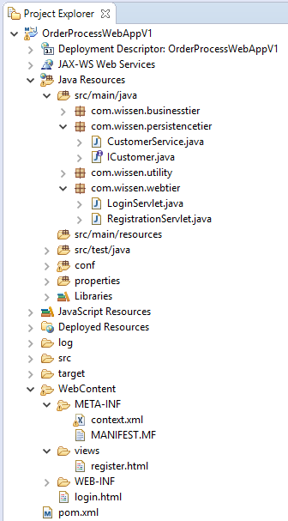
Login and Registration Implementation
Take help of built-in login screens that use bootstrap and css.
Link:
http://bootsnipp.com/snippets/featured/clean-modal-login-form

Slide 29
Setting up database connection pool
JNDI stands for Java Naming and Directory Interface.
JNDI allows distributed applications to look up services in an abstract, resource-independent way.
The most common use case is to set up a database connection pool on a Java EE application server. Any application that's deployed on that server can gain access to the connections they need using the JNDI name java:comp/env/<databasename> without having to know the details about the connection.
This has several advantages:
If you have a deployment sequence where apps move from dev->int->test->prod environments, you can use the same JNDI name in each environment and hide the actual database being used. Applications don't have to change as they migrate between environments.
You can minimize the number of folks who need to know the credentials for accessing a production database. Only the Java EE app server needs to know if you use JNDI.
Tomcat provides a JNDI InitialContext implementation instance for each web application running under it, in a manner that is compatible with those provided by a Java Enterprise Edition application server.

Slide 30
Setting up database connection pool
Create file, context.xml with the following contents and place in in WebContent/META-INF folder
<?xml version="1.0" encoding="UTF-8"?>
<Context>
<!-- Specify a JDBC datasource -->
<Resource name="jdbc/orderprocessDB" auth="Container" type="javax.sql.DataSource" username="root" password="root" driverClassName="com.mysql.jdbc.Driver" url="jdbc:mysql://localhost:3306/orderprocess" maxActive="10" maxIdle="4" />
MySQL
</Context>
<?xml version="1.0" encoding="UTF-8"?>
Oracle
<Context>
<!-- Specify a JDBC datasource -->
<Resource name="jdbc/orderprocessDB" auth="Container" type="javax.sql.DataSource" username= "scott" password= "tiger" driverClassName= "oracle.jdbc.OracleDriver"
url= "jdbc:oracle:thin:@//localhost:1521/orcl" maxActive="10" maxIdle="4" />
</Context>

Slide 31
Setting up database connection pool
The InitialContext is configured as a web application is initially deployed, and is made available to web application components (for read-only access).
All configured entries and resources are placed in the java:comp/env portion of the JNDI namespace, so a typical access to a resource - in this case, to a JDBC data source - would look something like this:
// Obtain our environment naming context context = new InitialContext();
envContext = (Context) context.lookup("java:comp/env");
// Look up our data source
dataSource = (DataSource) envContext.lookup("jdbc/orderprocessDB");
Note: The above statements are to be placed in the DAO class methods.
Note: DataSource doesn’t implement AutoCloseable interface. Use try..catch block but not try .. with resources

Slide 32
Java EE
ServletConfig object ServletContext object

Slide 33
ServletConfig Interface
Every Servlet has its own ServletConfig object which holds initialization parameters.
Initialization parameters can be made available in web.xml or in annotations.
The methods used to read initialization parameters are:
Another useful instance method of ServletConfig object is:
Servlet Context getServletContext()
returns a reference to a ServletContext object, used by the caller to interact with its servlet container
•
•
String getInitParameter(String) Enumeration getInitParameterNames()
To configure the initialization parameters for Servlet in web.xml:
<servlet>
<servlet-name>Servlet Name</servlet-name>
<servlet-class>package-name.servlet-classname</servlet-class>
< init-param>
<param-name>param1</param-name>
<param-value>value1</param-value>
</init-param>
.........
</servlet>

Slide 34
Initialization parameters for a Servlet through annotations
The initial parameters for a Servlet can set using annotations, @WebInitParam
The @WebInitParam annotation supports two attributes:
name - The name of the parameter
value - The value of the parameter
Using @WebInitParam annotation to specify servlet init parameters
@WebServlet(name = "Servletname", urlPatterns = {"/urlpattern"}, initParams = {@WebInitParam(name="param1", value="value1"), @WebInitParam(name="param2", value="value2")}
)
@WebServlet(name="InitParamsServlet",urlPatterns="/InitParamsServlet",
Example
initParams={@WebInitParam(name="dbname",value="MySQL"), @WebInitParam(name="username", value="root"), @WebInitParam(name="password", value="root123"), @WebInitParam(name="tablename",value="emp")
})
public class InitParamsServlet extends GenericServlet {
……….
}

Slide 35
Accessing initialization parameters in servlet
The Servlet Container creates the ServletConfig object during Servlet instantiation and stores
the initialization parameters and their values in it.
We can access the initialization parameters in init() method or in service() methods.
We know that init() method is invoked only once during its lifecycle during the servlet instantiation.
public void init() throws ServletException
To acquire the ServletConfig object within init() or service() methods,
getServletConfig() method of Servlet interface returns the object of ServletConfig

Slide 36
ServletContext Interface
public interface ServletContext
Defines a set of methods that a servlet uses to communicate with its servlet container, for example, to get the MIME type of a file, dispatch requests, or write to a log file.
There is one context per "web application" per Java Virtual Machine.
The ServletContext object is contained within the ServletConfig object, which the Web server provides the servlet when the servlet is initialized.
ServletContext object is created by the web container and the context parameters are obtained from deployment descriptor file, web.xml file.
There is no annotation support for context parameters.

Slide 37
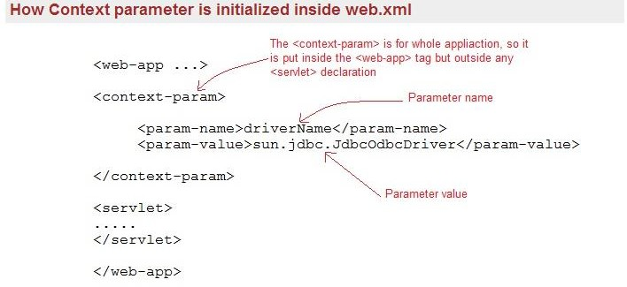
We can configure more than one context parameters.
Acquiring ServletContext object in Servlet:
ServletContext servletContext = this.getServletContext();
OR
ServletContext servletContext = getServletConfig().getServletContext();

Slide 38
ServletContext Interface
Web application initialization:
First, the web container reads the deployment descriptor file and creates a name/value pair for each <context-param> tag.
After creating the name/value pair it creates a new instance of ServletContext
It is the responsibility of the Container to give the reference of the ServletContext to the context init parameters.
The servlets and jsps which are part of the same web application can have the access to the ServletContext.
The Context init parameters are available to the entire web application.

Slide 39
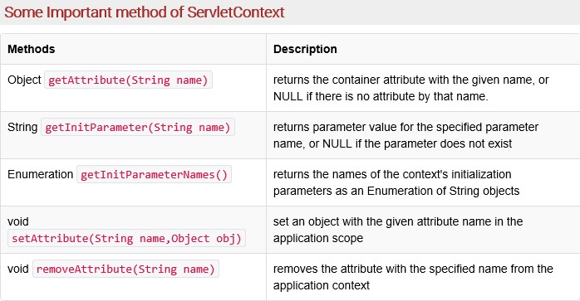
ServletContext Interface Methods

Slide 40

Thank You!

